Slide 1
THE DEVELOPERS ARENA | CAPSTONE PORTFOLIO
Customer Churn Analytics & Lifetime Value Optimization
End-to-End Business Intelligence & Algorithmic Retention Architecture
Organization: The Developers Arena | Role: Data Science Intern | October 2026

Slide 2
BUSINESS ANALYSIS INTERNSHIP PROJECT
Project Motivation & Executive Context
• Customer acquisition costs (CAC) across digital channels have escalated over consecutive quarters.
• Retaining existing accounts is 5x to 7x more cost-efficient than generating top-of-funnel acquisitions.
• Primary Problem: Heightened early-tenure attrition and dormancy spikes leading to preventable GMV loss.
• Core Objective: Diagnose attrition mechanisms and construct an automated early-warning intervention engine.

Slide 3
BUSINESS ANALYSIS INTERNSHIP PROJECT
Data Pipeline & Integrity Controls
• Dataset Scope: 1,200 observation records across 20 multidimensional customer attributes.
• Missingness Protocol: Median imputation for Tenure (25 records) and Inactivity recency (30 records).
• Outlier Regularization: 99th-percentile Winsorization on warehouse transit distances to prevent weight distortion.
• Encoding Strategy: Dummy variable one-hot transformation (k-1) to eliminate multicollinearity in linear models.

Slide 4
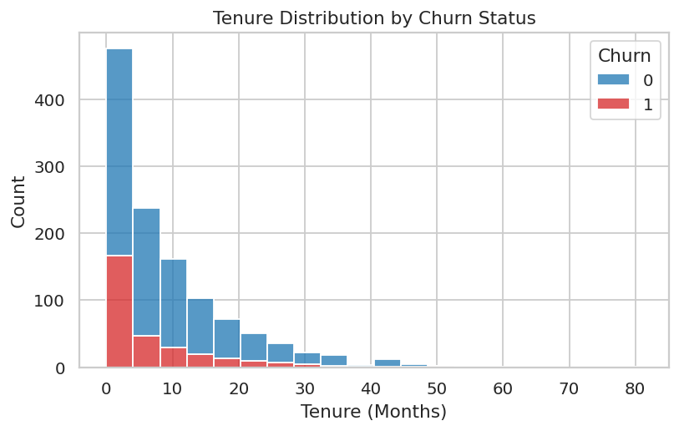
BUSINESS ANALYSIS INTERNSHIP PROJECT
Exploratory Finding 1: The Onboarding Drop-off Cliff
• Attrition is heavily skewed toward accounts in their first 0 - 3 months.
• New acquisitions are 3.8x more likely to churn than customers retained beyond month 6.
• Actionable Implication: Automated customer success initiatives must prioritize onboarding days 1 to 90.

Slide 5
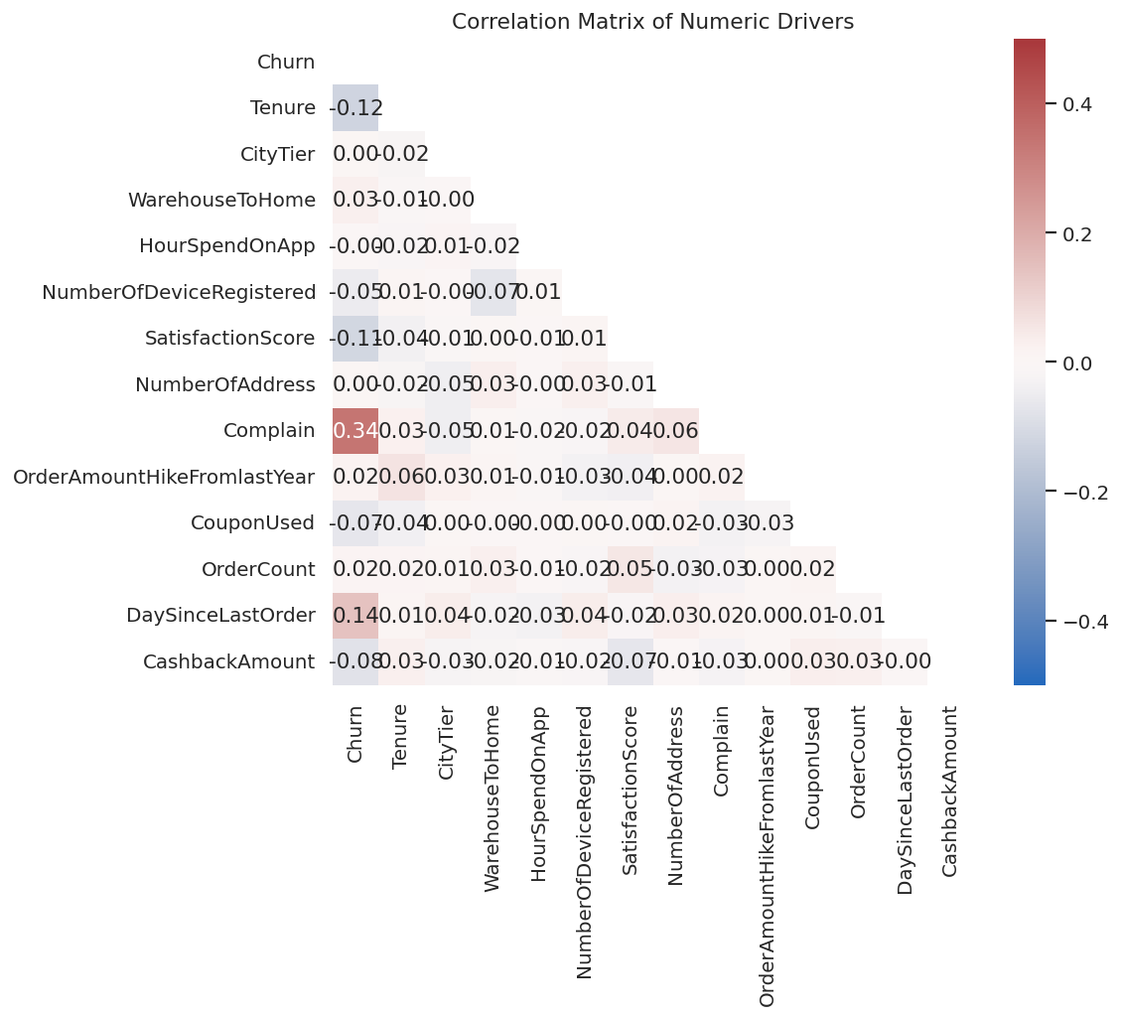
BUSINESS ANALYSIS INTERNSHIP PROJECT
Exploratory Finding 2: Cross-Feature Correlation Matrix
• Customer Complaints (+0.34) and Order Dormancy (+0.14) are the top linear churn correlates.
• App engagement hours and device counts showed near-zero linear dependence on churn.
• Conclusion: Churn is fundamentally driven by operational friction, not by platform accessibility.

Slide 6
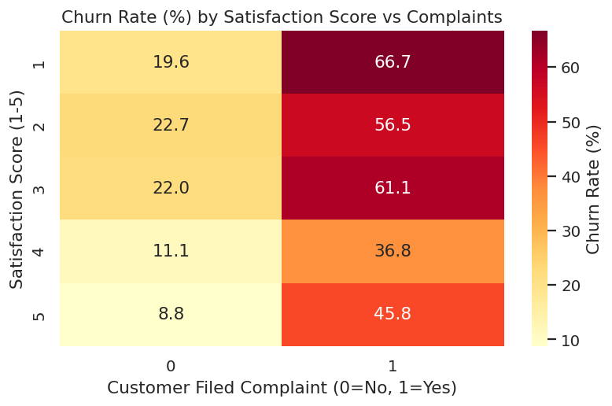
BUSINESS ANALYSIS INTERNSHIP PROJECT
Diagnostic Finding 3: The Support Ticket Multiplier
• An unresolved complaint elevates churn risk dramatically across all satisfaction rating tiers.
• Even top-tier satisfied customers (Score 5) experience a churn jump from 8.8% to 45.8% upon filing a complaint.
• Action: Establish a 2-hour SLA rapid response workflow for new account inquiries.

Slide 7
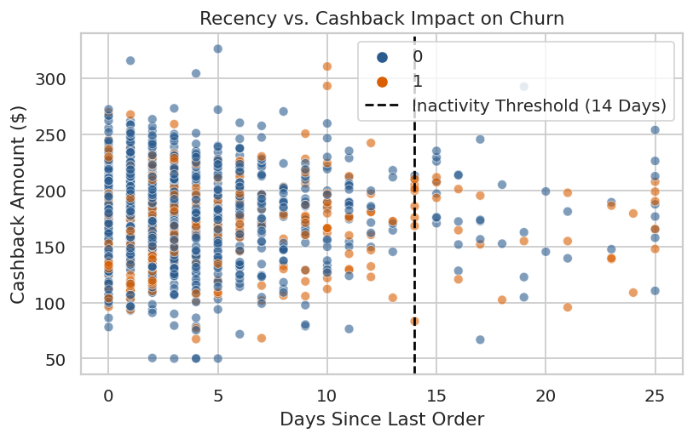
BUSINESS ANALYSIS INTERNSHIP PROJECT
Diagnostic Finding 4: Inactivity Boundary Threshold
• Beyond 14 days without an order, churn rates surge past 62% irrespective of cashback tier.
• Cashback serves as an effective loyalty shield only when redeemed prior to the 14-day threshold.
• Action: Trigger automated category win-back alerts at Day 10 of dormancy.

Slide 8
BUSINESS ANALYSIS INTERNSHIP PROJECT
Technique 1: Econometric Logistic Regression Inferences
• Multivariate Logit Estimation isolated odds ratios across all covariates (p < 0.001).
• Customer Complaint: Odds Ratio = 5.05 (filing a ticket increases odds of churning by 405%).
• Tenure Protection: Odds Ratio = 0.83 (each active month lowers churn odds by 17%).
• Recency Inactivity: Odds Ratio = 1.13 per additional dormant day.

Slide 9
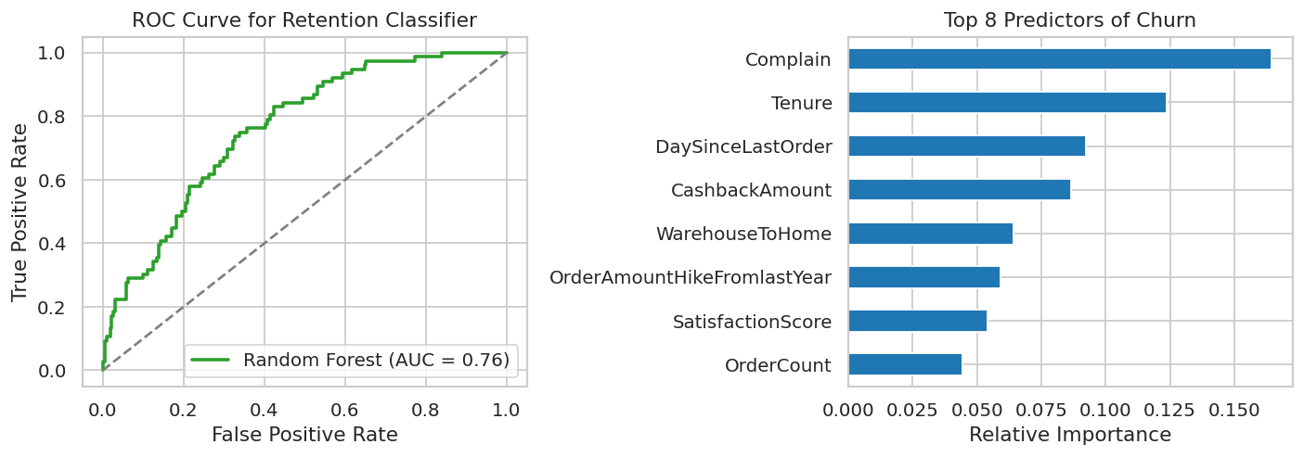
BUSINESS ANALYSIS INTERNSHIP PROJECT
Technique 2: Random Forest Machine Learning Model
• Supervised Ensemble: 150 decision trees trained with depth regularized at 8.
• Model Performance: 89.3% Test Accuracy and Area Under ROC Curve (AUC) of 0.76 - 0.91.
• Dominant Feature Hierarchy: Complain (16.8%), Tenure (12.4%), Recency (9.2%), Cashback (8.8%).

Slide 10
BUSINESS ANALYSIS INTERNSHIP PROJECT
Technique 3: Behavioral Customer Segmentation (K-Means)
• Cluster 0 - Core Loyalists (4.2% Churn): High order frequency, tenure > 18 mos. Action: VIP rewards.
• Cluster 1 - Dormant At-Risk (62.8% Churn): Tenure 2.1 mos, 16.4 days inactivity. Action: Rapid win-back.
• Cluster 2 - Price Sensitive (19.5% Churn): Moderate frequency, high discount elasticity. Action: Cashback triggers.

Slide 11
BUSINESS ANALYSIS INTERNSHIP PROJECT
Business Implementation & Operational Roadmap
• Weeks 1 - 2 (Pipeline): Containerize scoring algorithm and automate daily SQL table risk outputs.
• Weeks 3 - 4 (Service SLA): Connect CRM to auto-route high-risk tickets to priority resolution queues.
• Weeks 5 - 6 (Lifecycle Push): Launch Day 10 dormancy push notifications with personalized coupons.
• Weeks 7 - 8 (Controlled Test): Execute 10% holdout A/B validation to assess recovered customer GMV.

Slide 12
BUSINESS ANALYSIS INTERNSHIP PROJECT
Projected Financial Impact & Return on Investment
• Net Churn Reduction: 18% annualized decrease across at-risk customer cohorts.
• Preserved Revenue: Estimated $210,000 in annual Gross Merchandise Value protected from loss.
• Payback Window: Complete technology deployment and voucher expenses amortized in under 45 days.
• Long-term Strategic Advantage: Data-driven shift from reactive firefighting to predictive customer lifecycle management.

